Slide 1
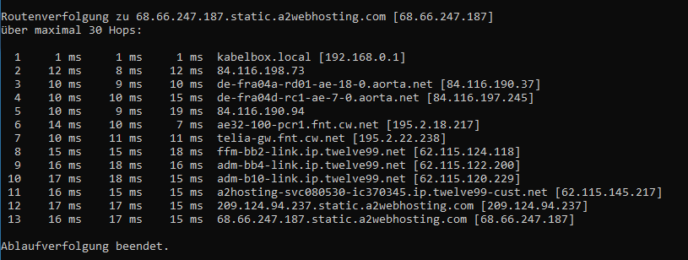
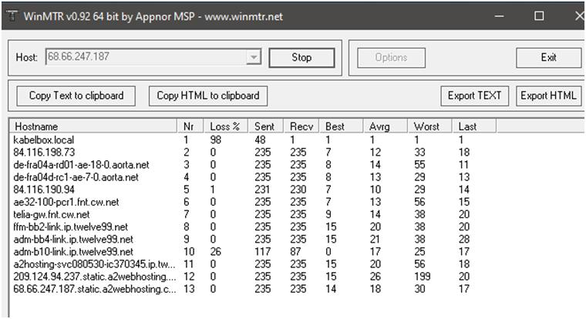
Group 1, https://loadedwithstuff.co.uk/
How many hops from your machine to your assigned website?
Which step causes the biggest delay in the route? What is the average duration of that delay?
Total of 13 hops
Hop 12, 26 ms

Slide 2
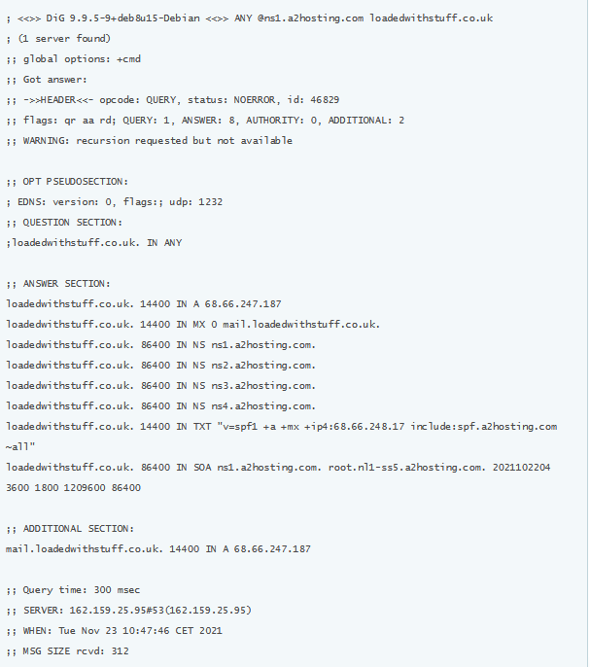
Group 1, https://loadedwithstuff.co.uk/
What are the main nameservers for the website?
ns1.a2hosting.com. ns2.a2hosting.com. ns3.a2hosting.com. ns4.a2hosting.com.
Found at: http://www.dnstools.ch/dns-nameserver.html Found at: http://www.dnstools.ch/dns-nameserver.html

Slide 3
Group 1, https://loadedwithstuff.co.uk/
Who is the registered contact?
OrgName: A2 Hosting, Inc.
OrgId: A2HOS
Address: P.O. Box 2998
City: Ann Arbor
StateProv: MI
PostalCode: 48106
Country: US
RegDate: 2004-03-16
Updated: 2021-10-13
Comment: http://www.a2hosting.com
Ref: https://rdap.arin.net/registry/entity/A2HOS
Found at: https://who.is/whois-ip/ip-address/68.66.247.187

Slide 4
Group 1, https://loadedwithstuff.co.uk/
What is the MX record for the website?
mail.loadedwithstuff.co.uk.
found at: http://www.dnstools.ch/dns-nameserver.html

Slide 5
Group 1, https://loadedwithstuff.co.uk/
Where is the website hosted?
It is hosted by: A2 Hosting, Inc.
Organization name: A2 Hosting, Inc
IP address: 68.66.247.187
AS(autonomous system) number and organization: AS55293 A2 Hosting, Inc.
AS name: A2HOSTING
Reverse DNS of the IP: 68.66.247.187.static.a2webhosting.com
City: Amsterdam
Country: Netherlands
Found at: https://hostingchecker.com/

